Slide 1
Memory and Storage in Computer Systems
An overview of Primary and Secondary Memory

Slide 2
Primary Memory
Primary memory, or main memory, is directly accessible by the CPU and is used to store data and programs that are actively being used. It is faster than secondary memory and includes:
Volatility: Loses content when power is turned off.
Speed: Fast access times.
Cost: Expensive per unit of data stored.
Types: RAM (volatile), ROM (non-volatile).

Slide 3
Secondary Memory
Secondary memory is used for long-term data storage and is non-volatile. It retains data without power and includes:
Non-volatility: Retains data when turned off.
Capacity: Higher storage capacity than primary memory.
Cost: Cheaper per unit of storage.
Types: HDDs, SSDs, Optical Disks, Flash Drives.

Slide 4
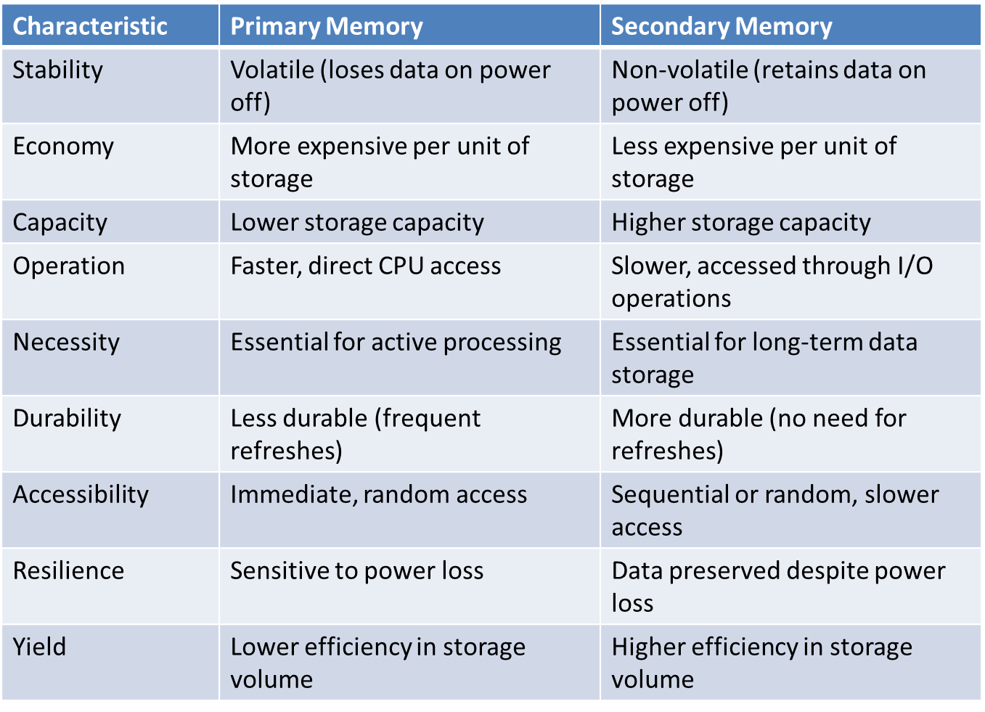

Slide 5
RAM (Random Access Memory)
RAM is a type of computer memory that is used to store data and machine code currently being used. RAM allows data items to be read or written in almost the same amount of time irrespective of the physical location of data inside the memory, which is why it's called "random access." Here are some key points about RAM:
Volatility: RAM is volatile, which means it loses its data when the device is turned off.
Speed: It provides high-speed data access and is much faster than secondary storage devices. This speed is essential for the efficient processing of tasks by the CPU.
Use: It is used as the main memory in a computer to hold the operating system, application programs, and data in current use so that they can be quickly reached by the device's processor.

Slide 6
ROM (Read-Only Memory)
ROM is a type of non-volatile memory used in computers and other electronic devices. Data stored in ROM cannot be electronically modified after the manufacture of the memory device. Here are some important aspects of ROM:
Non-volatility: Unlike RAM, ROM retains its data even when the computer is turned off.
Contents: Typically, it contains the bootloader or firmware, which is essential for booting the device.
Speed: While ROM is slower than RAM, it is stable and immutable, making it crucial for storing software that is rarely changed but frequently read, such as the system BIOS.

Slide 7
